Slide 1
APACHE STRUT 1.x
Group 2: Đào Trung Nam 18110031
Thiều Quang Khánh 18110022
Hồ Đắc Hiếu 18110014

Slide 2
Table of contents
01
Tomcat Server with Strut 1.x
02
Struts Controller
03
Struts Action
04
Demonstration

Slide 3
01
Tomcat Server with Strut 1.x

Slide 4
Introduction to Strut 1.x
First release of MVC based framework by the Apache Software foundation in May 2000.
Struts 1.x is a complete web framework
Provides complete web form components, validator, internalization, error handling, tiles layout, low learning curve and easy to implement it.
Based on Model-View-Controller (MVC) design paradigm
Implementation of JSP Model 2 Architecture.

Slide 5
Overview of the Struts Framework:
Struts 1.x Architecture
The Struts framework is composed of approximately classes and interfaces which are organized in about 12 top level packages. Along with the utility and helper classes framework also provides the classes and interfaces for working with controller and presentation by the help of the custom tag libraries. It is entirely on to us which model we want to choose.

Slide 6
The views of the Struts architecture are:
Struts 1.x Architecture
The Struts View Components:
The Struts Controller Components:
The Struts Model Components:
The view components are responsible for presenting information to the users and accepting the input from them. They are responsible for displaying the information provided by the model components. Mostly we use the Java Server Pages (JSP) for the view presentation. To extend the capability of the view we can use the Custom tags, java script etc.
Whenever a user request for something, then the request is handled by the Struts Action Servlet. When the ActionServlet receives the request, it intercepts the URL and based on the Struts Configuration files, it gives the handling of the request to the Action class. Action class is a part of the controller and is responsible for communicating with the model layer.
The model components provides a model of the business logic behind a Struts program. It provides interfaces to databases or back- ends systems. Model components are generally a java class. There is not any such defined format for a Model component, so it is possible for us to reuse Java code which are written for other projects. We should choose the model according to our client requirement.

Slide 7
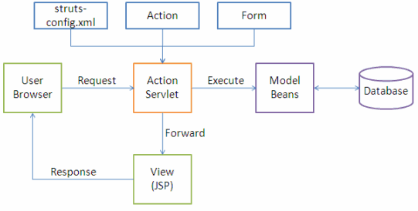
How Struts Work?
Struts 1.x Architecture
The following events happen when the Client browser issues an HTTP request.
• The ActionServlet receives the request.
• The struts-config.xml file contains the details regarding the Actions, ActionForms, ActionMappings and ActionForwards.
• During the startup the ActionServelet reads the struts-config.xml file and creates a database of configuration objects. Later while processing the request the ActionServlet makes decision by refering to this object.

Slide 8
How Struts Work?
Struts 1.x Architecture
When the ActionServlet receives the request it does the following tasks.
• Bundles all the request values into a JavaBean class which extends Struts ActionForm class.
• Decides which action class to invoke to process the request.
• Validate the data entered by the user.
• The action class process the request with the help of the model component. The model interacts with the database and process the request.
• After completing the request processing the Action class returns an ActionForward to the controller.
• Based on the ActionForward the controller will invoke the appropriate view.
• The HTTP response is rendered back to the user by the view component.

Slide 9
Tomcat Server
Apache Tomcat Overview
- As the reference implementation of Java Servlet and Java Server Pages (JSP), Tomcat was started at Sun Microsystems, which later donated the code base to the Apache Software Foundation.
- Since then, multiple volunteers from Sun contributed to the product which then led to a a top-level Apache project designation in 2005. Nowadays, Apache Tomcat is widely used by many companies as it implements many of the Java EE specifications, such as:
Java Servlet
JavaServer Pages,
Java Expression Language,
Java WebSockets.
Apache Tomcat

Slide 10
Tomcat Server
What Is Tomcat Used For?
Tomcat is used for web applications written in Java that don't require full Java EE specifications, but still need a reliable tool.
The reason Tomcat is not really a full application server is because it acts only as a Web server and Servlet container. It doesn’t provide the full feature set from the Java EE, but that isn't necessarily a disadvantage. Many applications require just the features that Tomcat provides, so it doesn't make sense to go with the heavier tools. You can use Apache Tomcat for production applications that process thousands of requests if the features it provides is enough. In any case, Tomcat is a production-ready tool.
Apache Tomcat

Slide 11
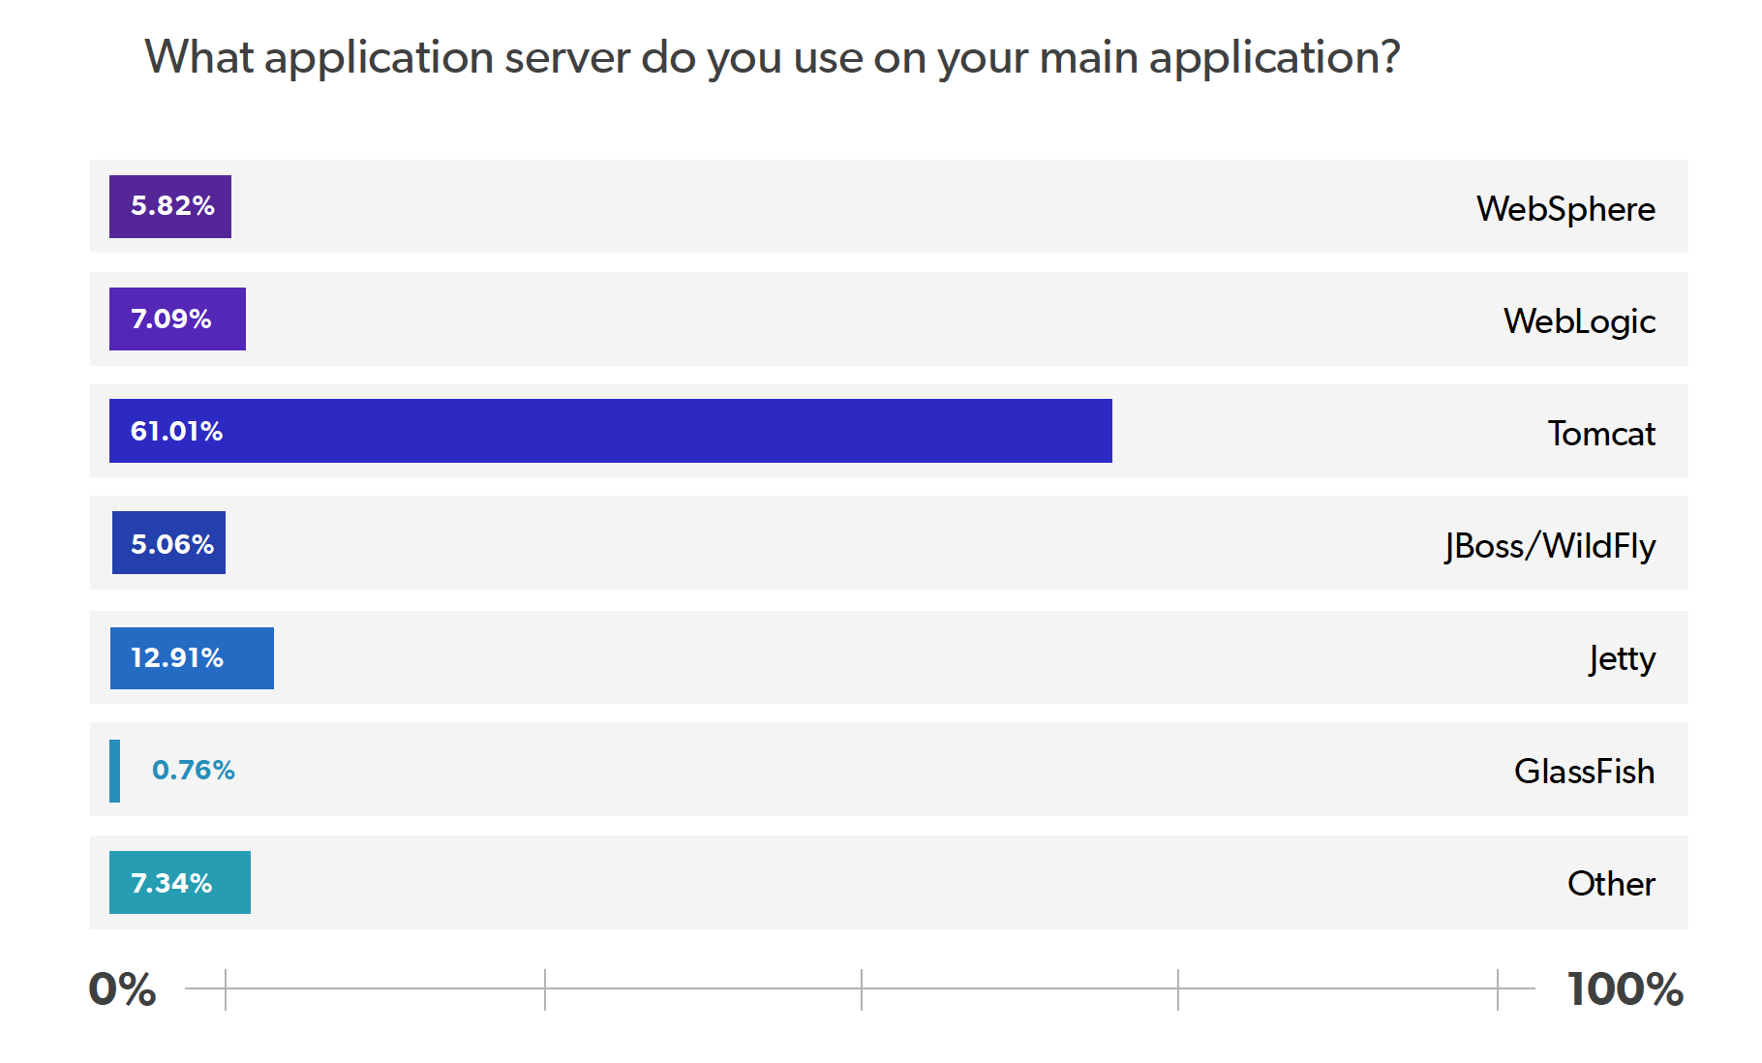
Tomcat Server
Popularity of Tomcat
- This is due to the fact that it is a very lightweight tool and it is free. It offers the most basic functionality needed by many applications, its startup time is quite fast, and the redeploy times are much lower compared to other tools on the market.
- If you ever run into an issue, the extensive documentation will likely help you find a solution. Tomcat has very good documentation available, and what is not in the official documentation, you find it on the internet as there are many wide ranges of tutorials available.
- It's also important to note that Tomcat isn't a one size fits all solution for Java applications. Picking the right server always depends on the needs presented by the application.

Slide 12
02
Struts Controller

Slide 13
Struts Controller
The class org.apache.struts.action.ActionServlet is the heart of the Struts Framework. It is the Controller part of the Struts Framework. ActionServlet is configured as Servlet in the web.xml file as shown in the following code snippets.
<!-- Standard Action Servlet Configuration (with debugging) --> <servlet> <servlet-name>action</servlet-name> <servlet-class>org.apache.struts.action.ActionServlet</servlet-class> <init-param> <param-name>config</param-name> <param-value>/WEB-INF/struts-config.xml</param-value> </init-param> <init-param> <param-name>debug</param-name> <param-value>2</param-value> </init-param> <init-param> <param-name>detail</param-name> <param-value>2</param-value> </init-param> <load-on-startup>2</load-on-startup> </servlet>
This servlet is responsible for handing all the request for the Struts Framework, user can map the specific pattern of request to the ActionServlet. <servlet-mapping> tag in the web.xml file specifies the url pattern to be handled by the servlet. By default it is *.do, but it can be changed to anything. Following code form the web.xml file shows the mapping.
<!-- Standard Action Servlet Mapping --> <servlet-mapping> <servlet-name>action</servlet-name> <url-pattern>*.do</url-pattern> </servlet-mapping>
The above mapping maps all the requests ending with .do to the ActionServlet. ActionServlet uses the configuration defined in struts-config.xml file to decide the destination of the request. Action Mapping Definitions (described below) is used to map any action.
Notes:
In this section I will describe you the Controller part of the Struts Framework. I will show you how to configure the struts-config.xml file to map the request to some destination servlet or jsp file.

Slide 14
03
Struts Action

Slide 15
Struts flow of control
I
II
The user requests a form. The input form is built with the Struts html: tags. These tags associate a bean with the form so that you can prepopulate the form with values from your application, so that you can redisplay incorrectly filled out forms, and so that Struts knows where to store the request parameters when the form is submitted.
The form is submitted to a URL of the form blah.do. The form contains an ACTION ending in blah.do. The Struts system receives the request, where an action mapping in struts-config.xml associates the address with an Action object.
III
IV
The execute method of the Action object is invoked. One of the arguments to execute is a form bean that is automatically created and whose properties are automatically populated with the incoming form data. Once it examines the user input data in the bean, the execute method invokes business logic and data-access logic, placing the results in normal beans stored in the request, session, or application scope. Finally, the execute method uses mapping. findForward to return various conditions that are mapped by struts-config.xml to JSP pages.
Struts forwards the request to the appropriate JSP page. Struts normally invokes the results page with RequestDispatcher.forward, although request.sendRedirect is occasionally used (e.g., with session-scoped data). In most real applications, the results page uses bean:write or the JSP 2.0 EL to output bean properties.
Notes:
Before writing your first Struts application, you need to understand the normal flow of execution through the Struts framework. Figure illustrates the apparent execution flow of the request through the Struts framework. We use the word apparent because, behind the scenes, the Struts system handles numerous internal steps. The following list summarizes the flow

Slide 16
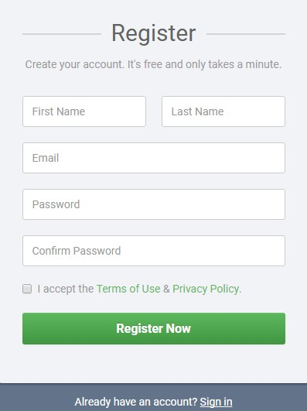
One result mapping Multiple result mappings
One result mapping
Multiple result mappings
Same output page in all cases
Different output pages depending on the input
Example: Invalid password
Example: Password must be at least 8 characters, at most 20 characters, password must not contain special characters…

Slide 17
04
Demonstration

Slide 18

Thanks
?
Any question?
?
?
Please keep this slide for attribution

